Slide 1


Engineering Physics (EN3BS05)
Ms Bhawna Kshirsagar
Medi-Caps University, Indore

Slide 2
Syllabus
Unit 1. Lasers and Optical Fiber
Unit 2. Interference and Diffraction
Unit 3. Quantum Mechanics
Unit 4. Mechanics and Crystal Physics
Unit 5. Polarization, Acoustics and Superconductivity

Slide 3
Scheme 3-1-2
3- Lectures
1- Tutorial
2- Laboratory Work
Total Credit: 5
Ms. Bhawna Kshirsagar , Assistant Professor (Physics Department) Medi-Caps University, Indore

Slide 4
EN3BS05 Engineering Physics 3-1-2
Text Books
Text Book of Optics by S. Chand Publication
Gour and Gupta , Engineering Physics, Dhanpat Rai Publication
S. L. Gupta, Engineering Physics
Text Book of Engineering Physics by M.N. Avadhanulu and P.G. Kshirsagar (Acoustics, Superconductivity)
Reference Books
Dr. M. N. Avadhanulu, Dr. R. S. Hemne, An Introduction to Laser- Theory and Applications. S. Chand Publications
Web Resources
http://phet.colarado.edu/en/simulations.
http://nptel.ac.in/courses/122103011/39.
Ms. Bhawna Kshirsagar , Assistant Professor (Physics Department) Medi-Caps University, Indore

Slide 5
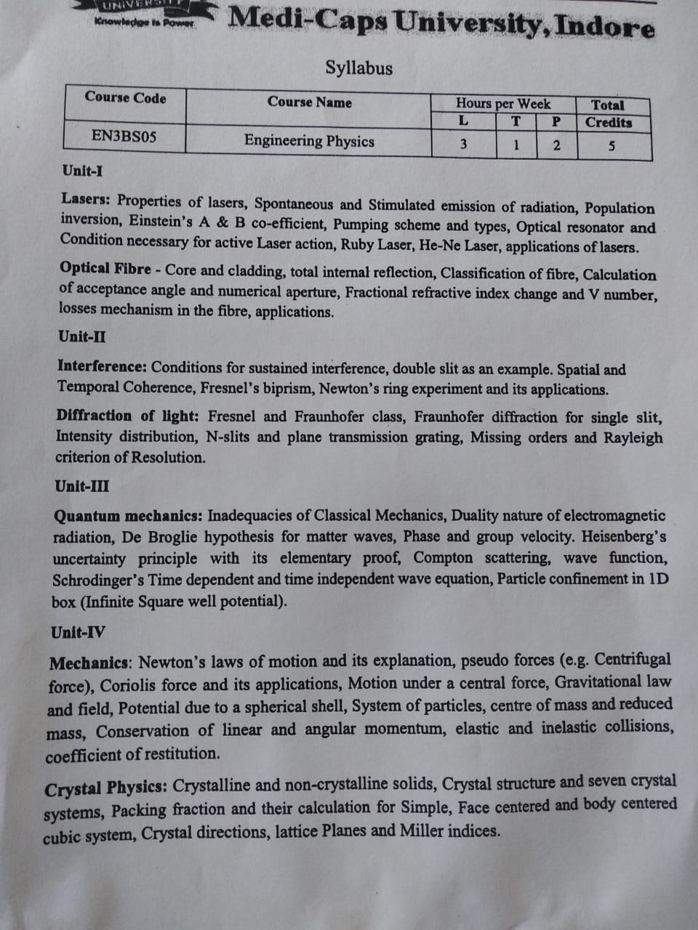

Slide 6
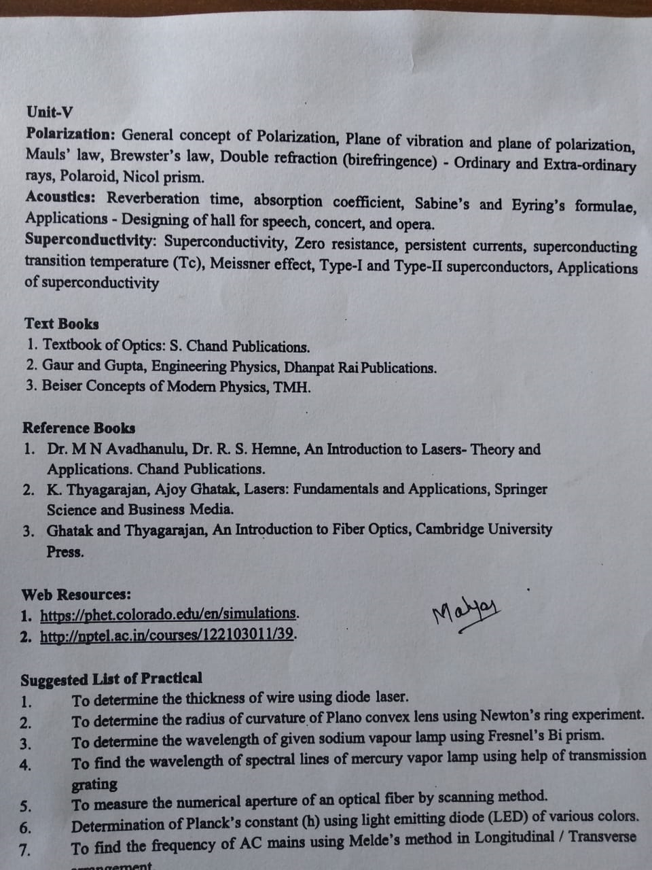

Slide 7
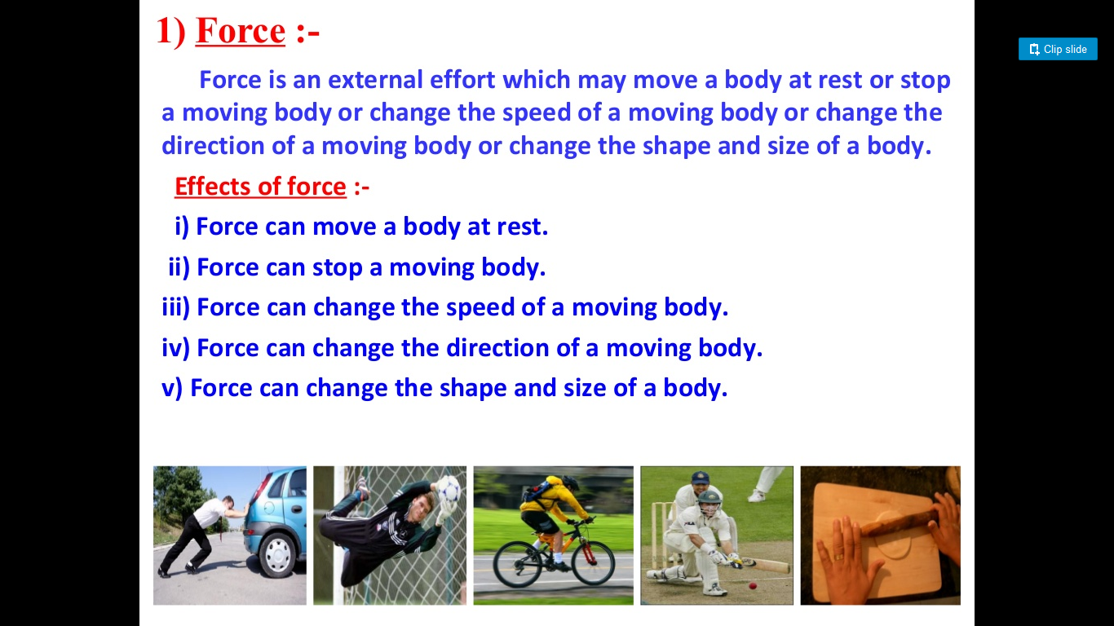
Unit IV Mechanics

Slide 8
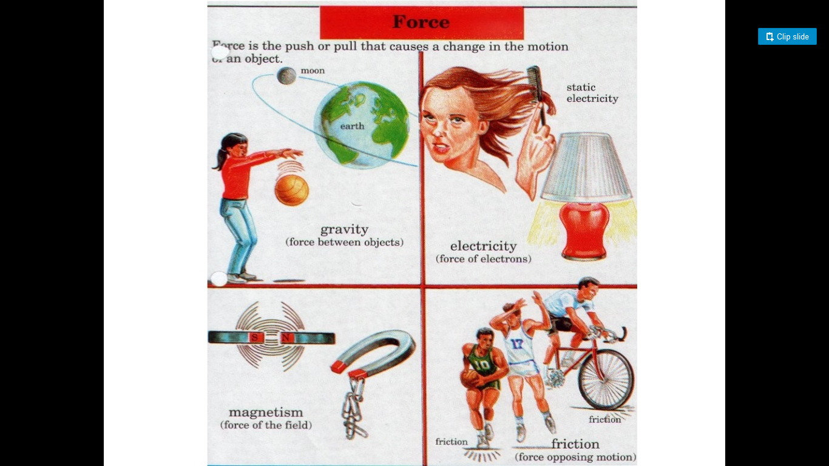

Slide 9
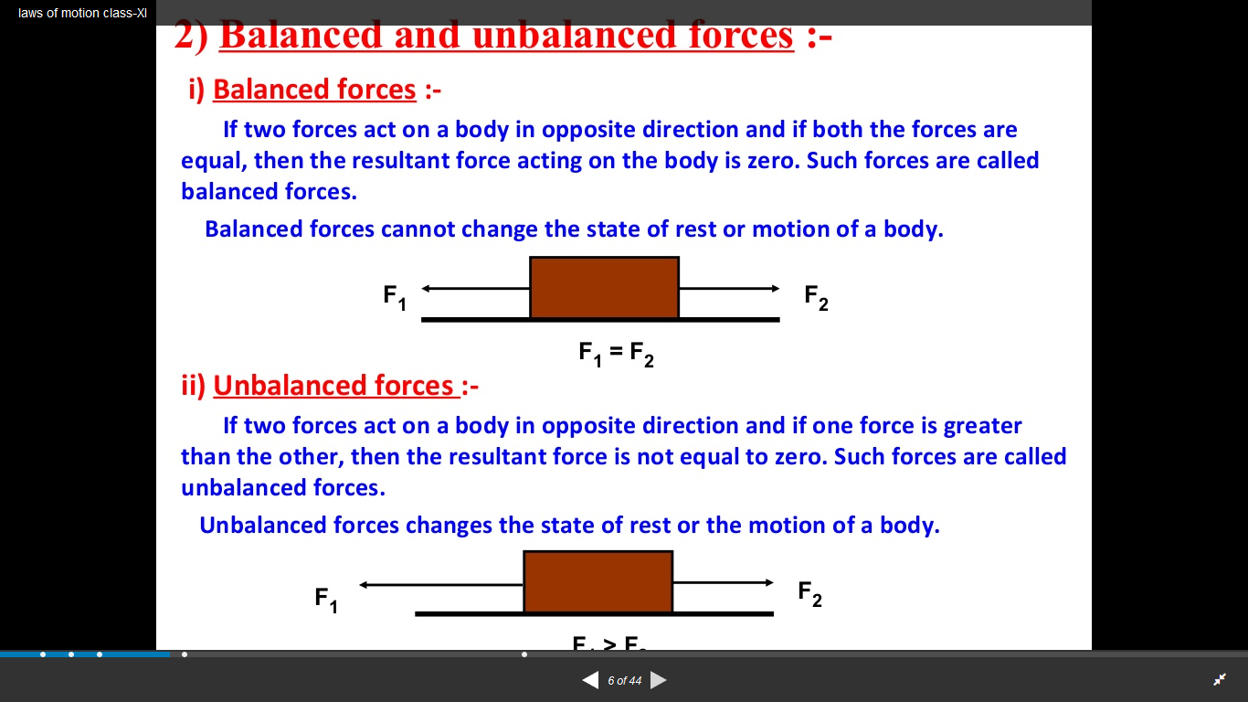

Slide 10
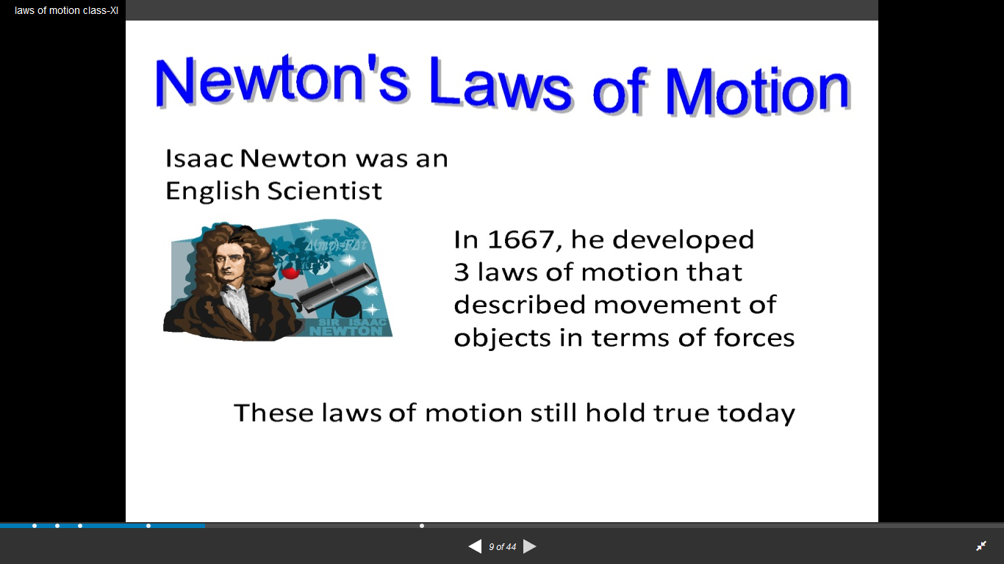
Newton’s Laws of Motion

Slide 11
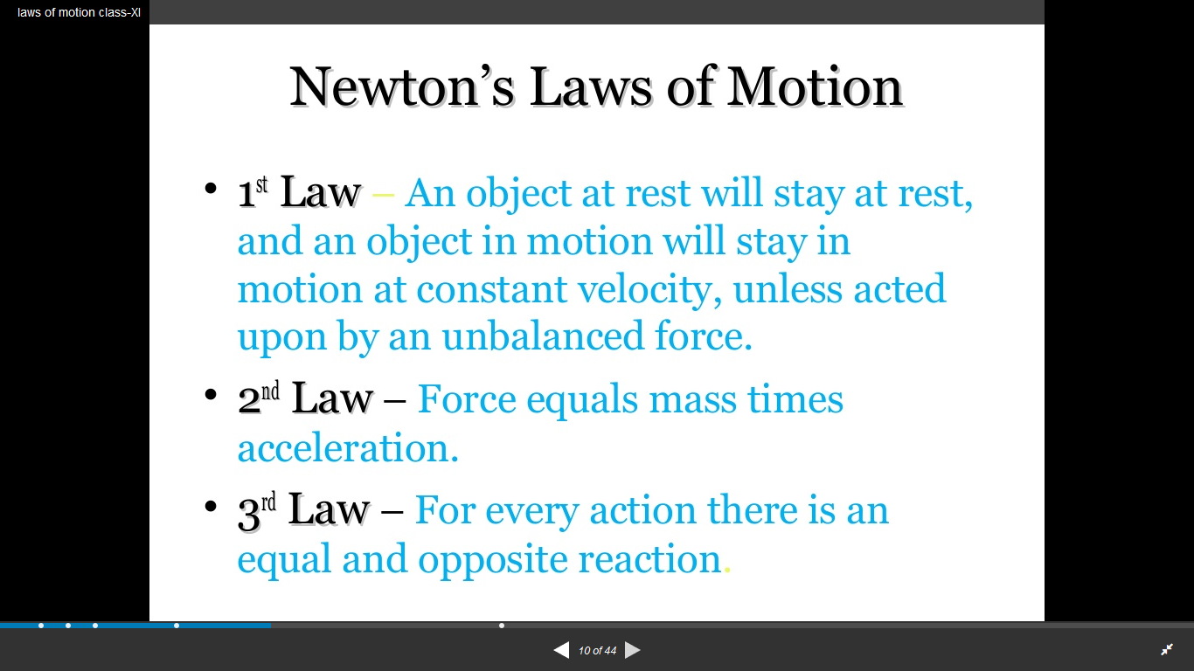
Statement:

Slide 12
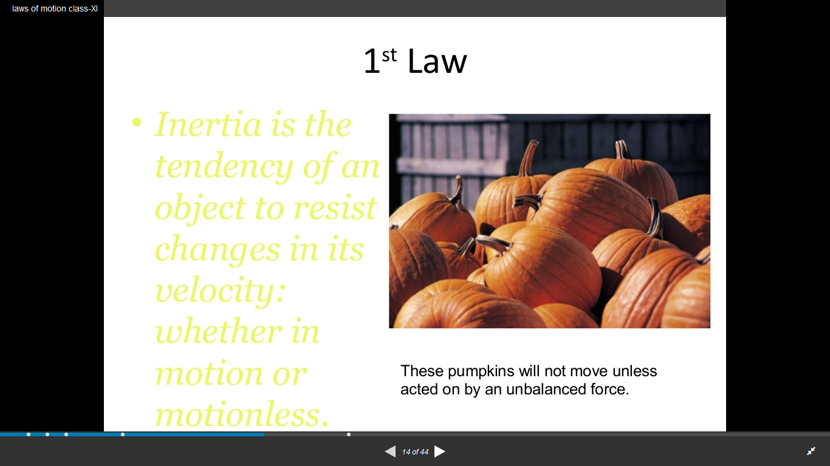
First law also called as Law of Inertia

Slide 13
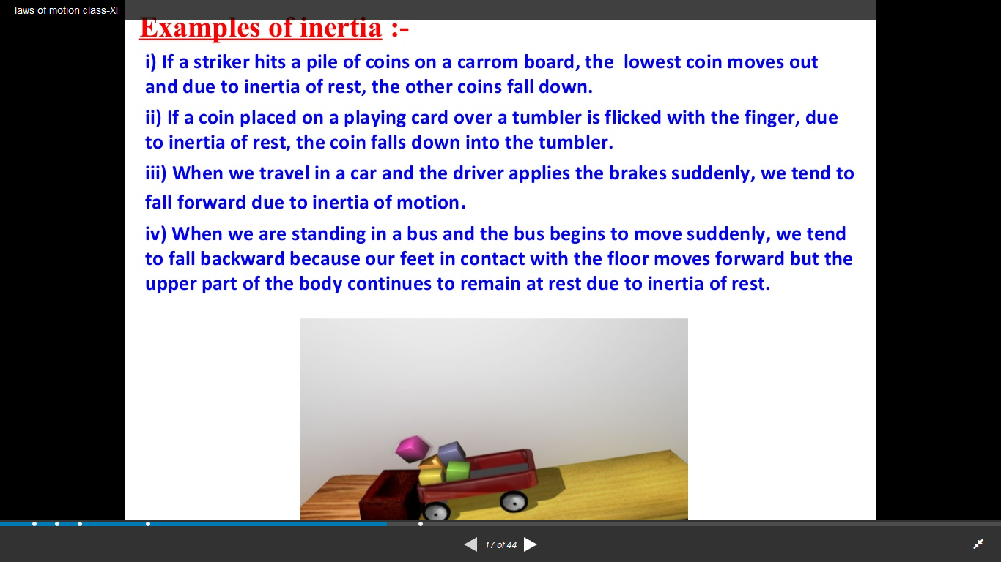

Slide 14
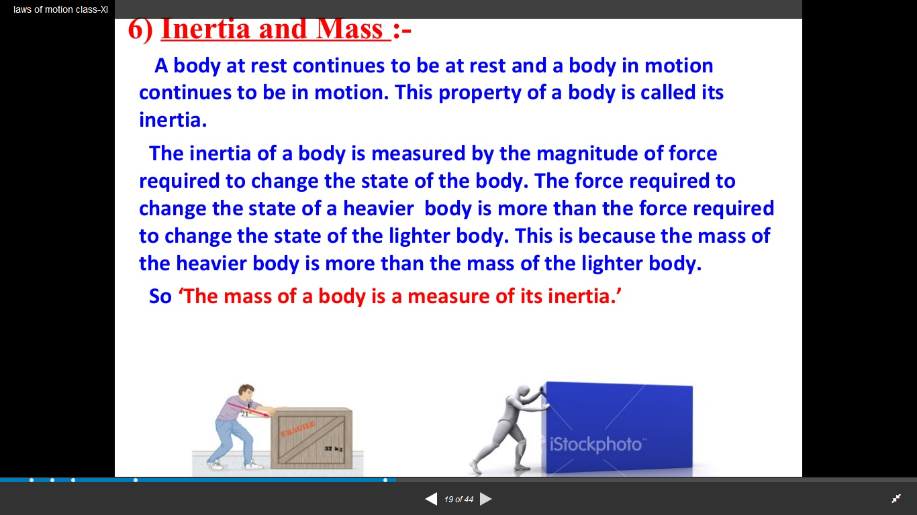

Slide 15
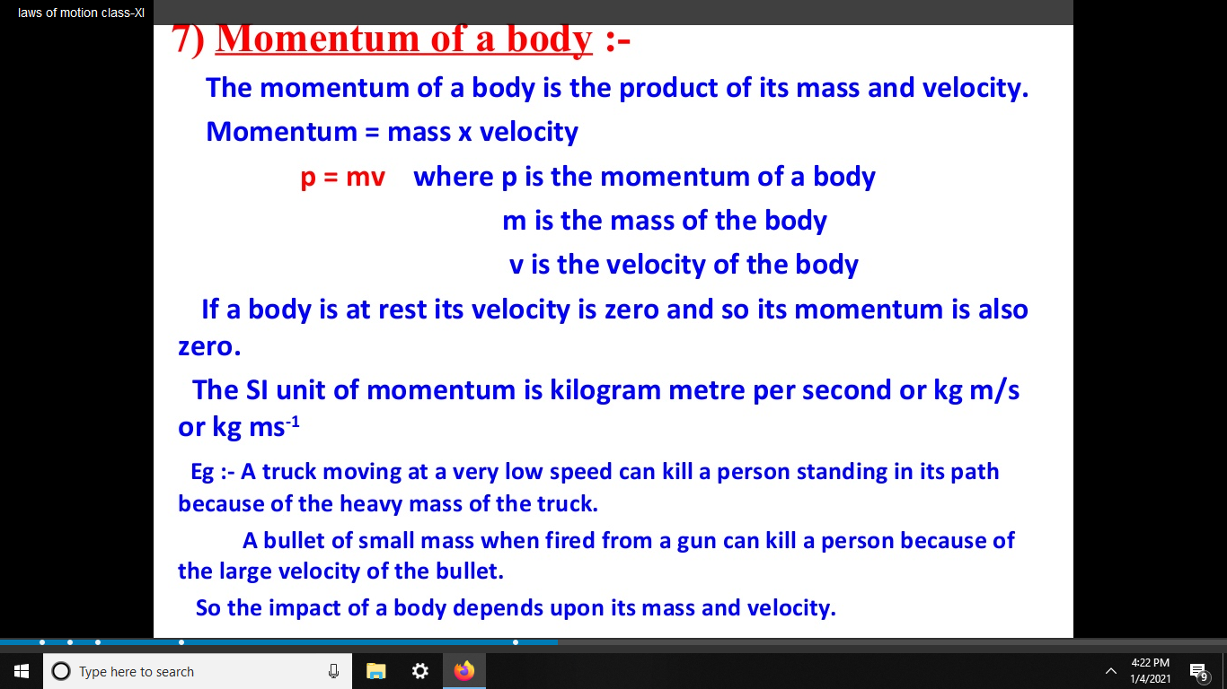

Slide 16
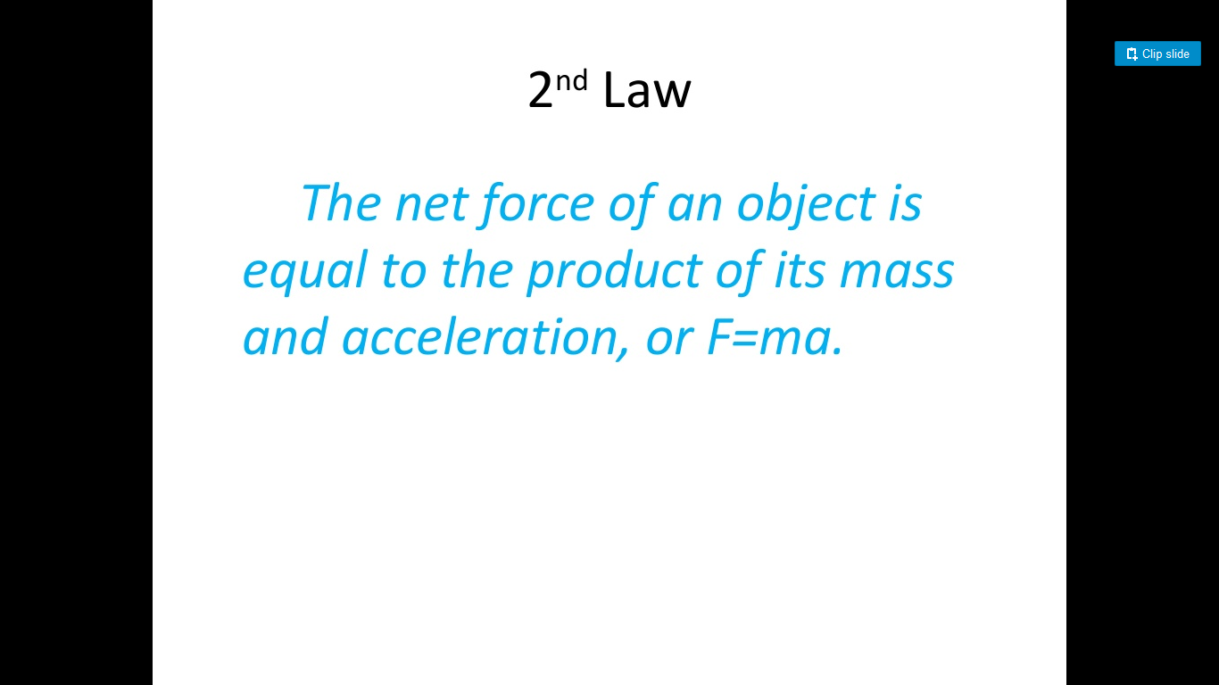
Newton’s Second Law

Slide 17
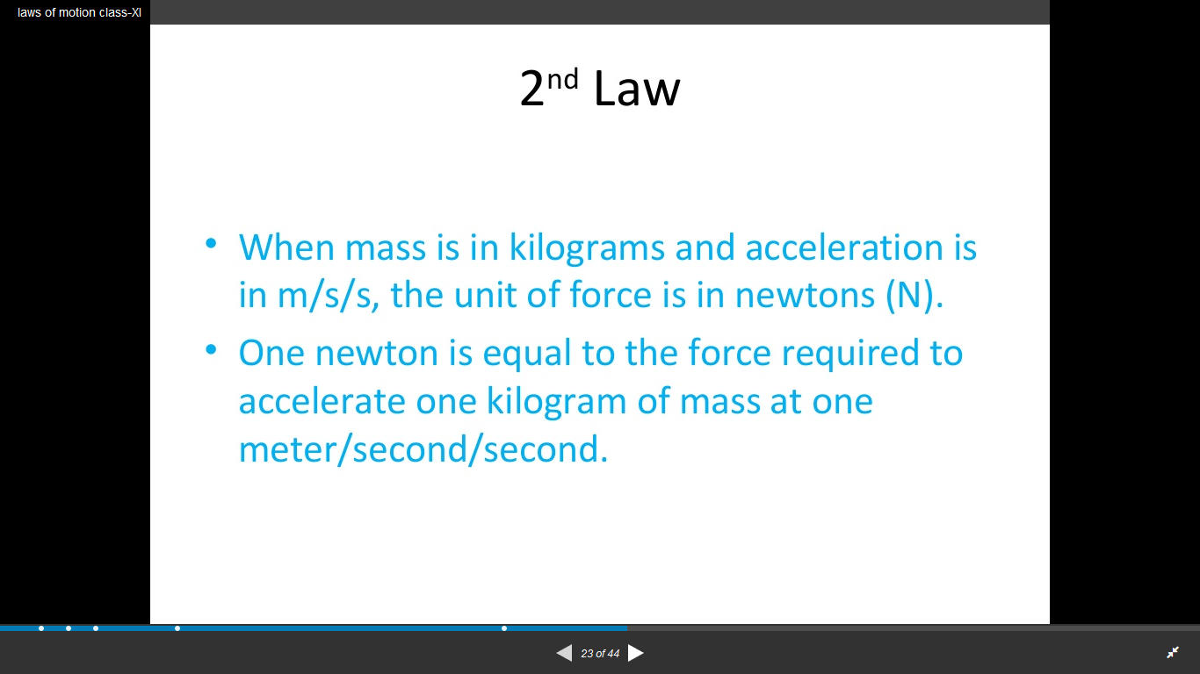

Slide 18
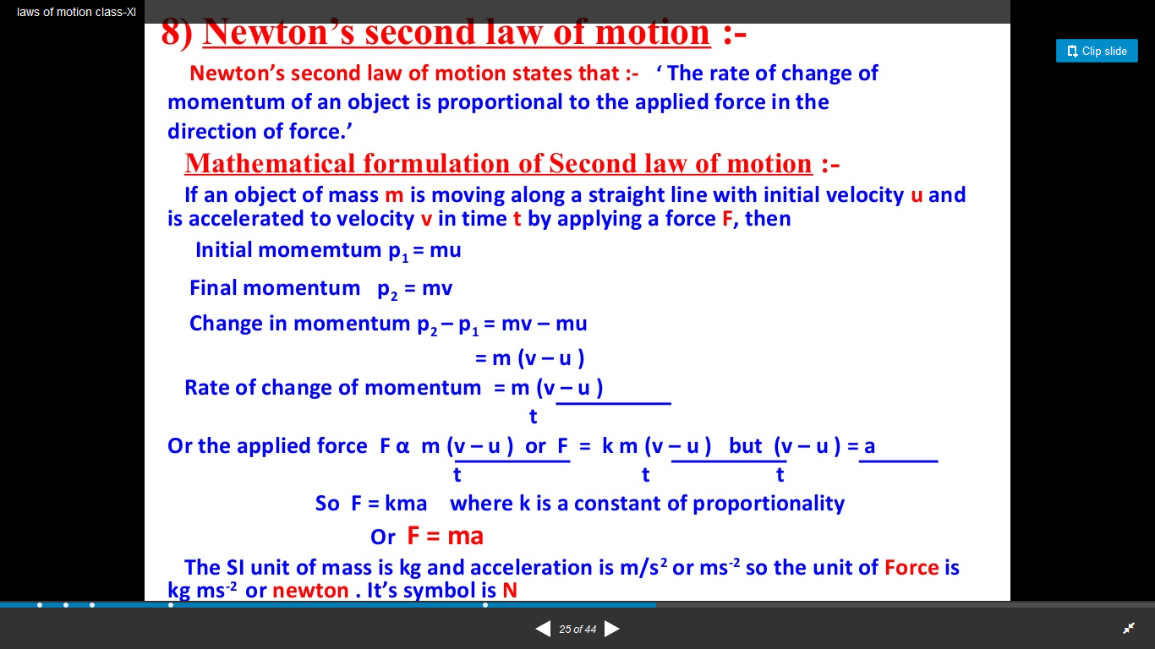

Slide 19
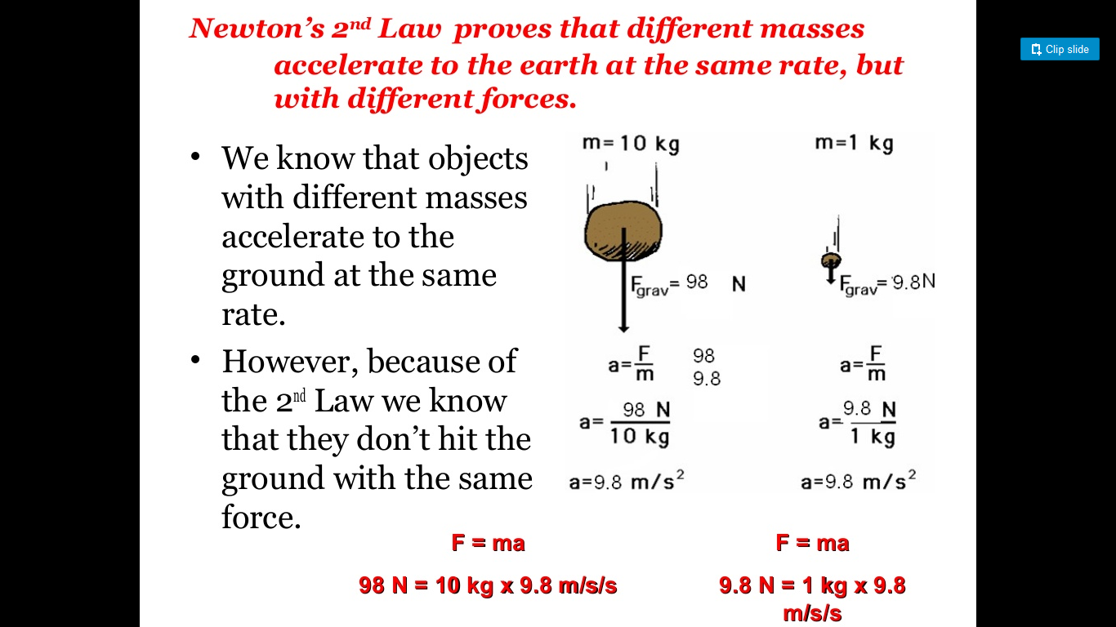

Slide 20
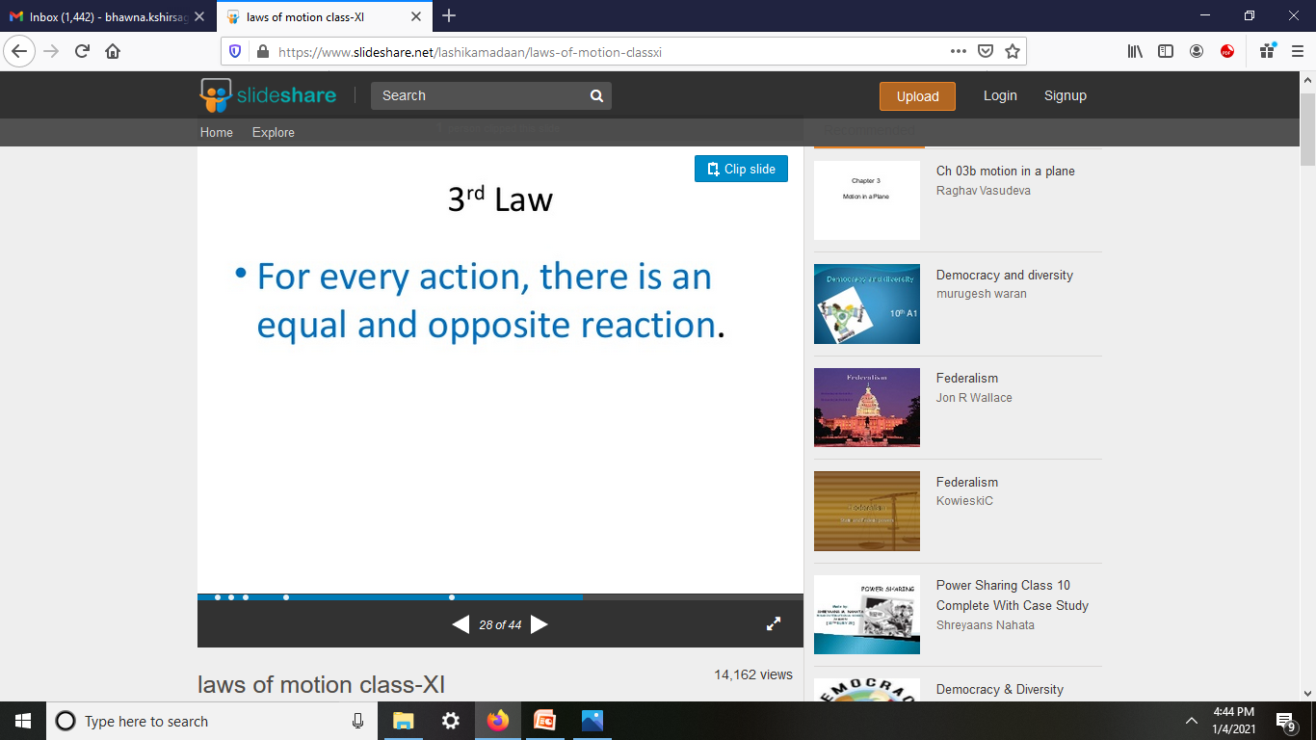

Slide 21
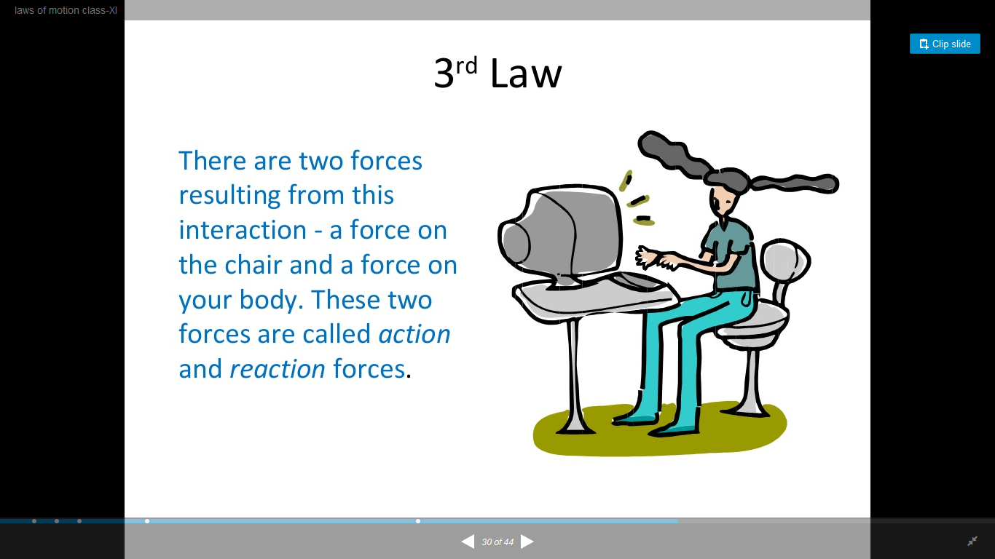

Slide 22
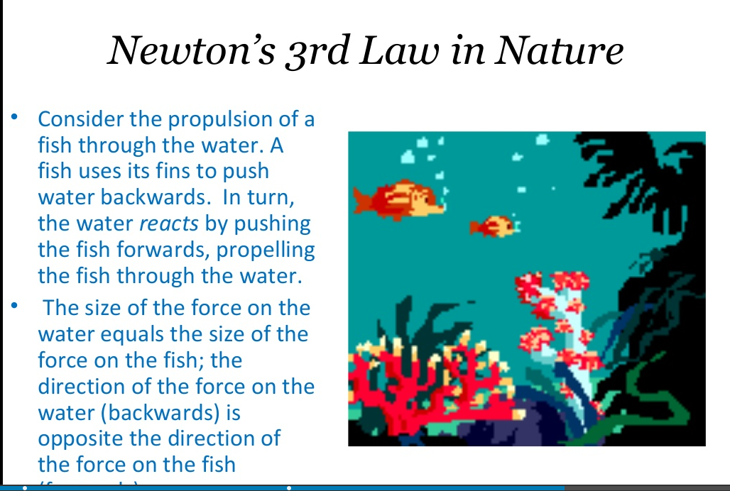

Slide 23
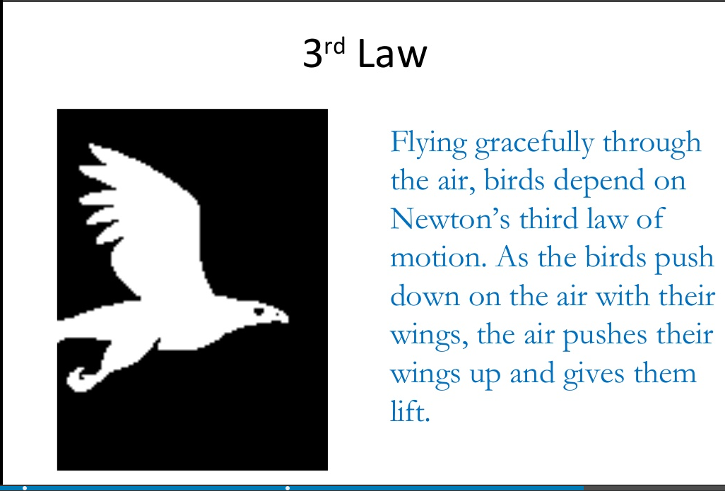

Slide 24
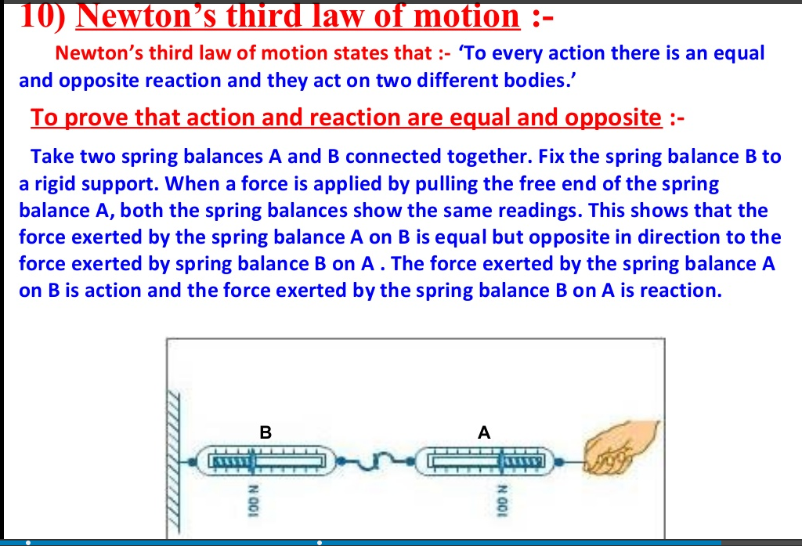

Slide 25
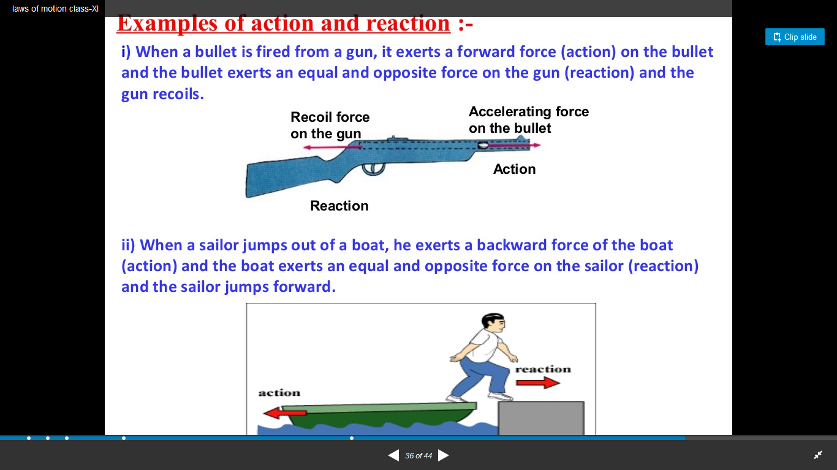

Slide 26
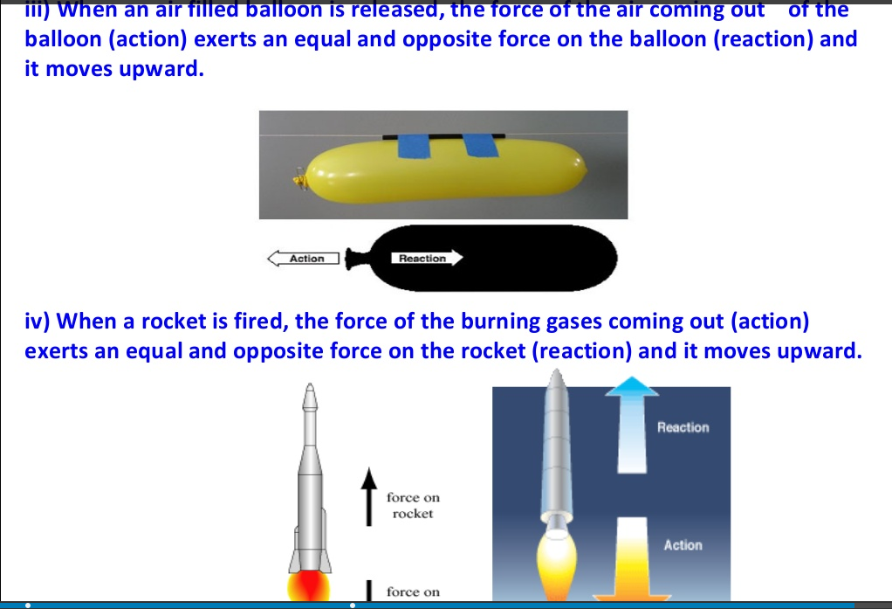

Slide 27
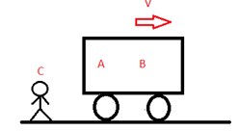
Frame of Reference
Let’s consider the following figure:
If we ask A what velocity of B is, he will say it is at rest.
But if we ask the same question to C, he will say B is moving with a velocity V in the positive X direction.
So we can see before specifying the velocity we have to specify in which frame we are or in simple terms, we need to define a frame of reference.

Slide 28
Types of Frame of Reference
Inertial Frame of Reference
2. Non-inertial Frame of Reference

Slide 29
Inertial Frame of Reference
An inertial frame of reference is a frame where Newton’s law holds true. That means if no external force is acting on a body it will stay at rest or remain in uniform motion.
Suppose a body is kept on the surface of the earth, for a person on earth it is at rest while for a person on the moon it is in motion so which is my inertial frame here?
Actually, the term inertial frame is relative i.e. first we assume a reference frame to be the inertial frame of reference. So a more general definition of an inertial frame would be: Inertial frame is at rest or moves with constant velocity with respect to my assumed inertial reference frame.

Slide 30
Non-inertial Frame of Reference
non-inertial frame is a frame that is accelerated with respect to the assumed inertial frame of reference.
Newton’s law will not hold true in these frames. So in the above example if I assume earth to be an inertial reference frame the moon becomes a non-inertial reference frame as it is in accelerated motion with respect to earth.
But if we want to make Newton’s law hold here we need to take some mysterious forces also known as pseudo forces.

Slide 31

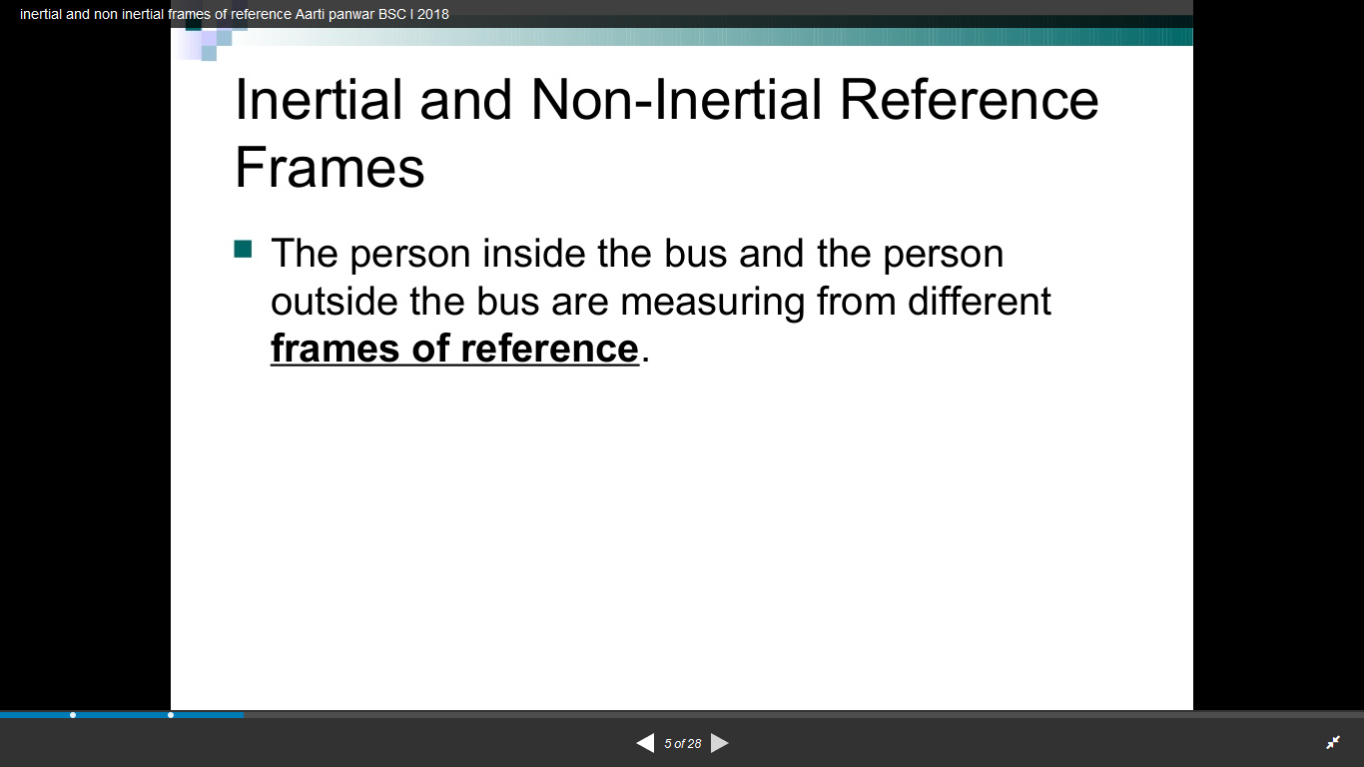

Slide 32
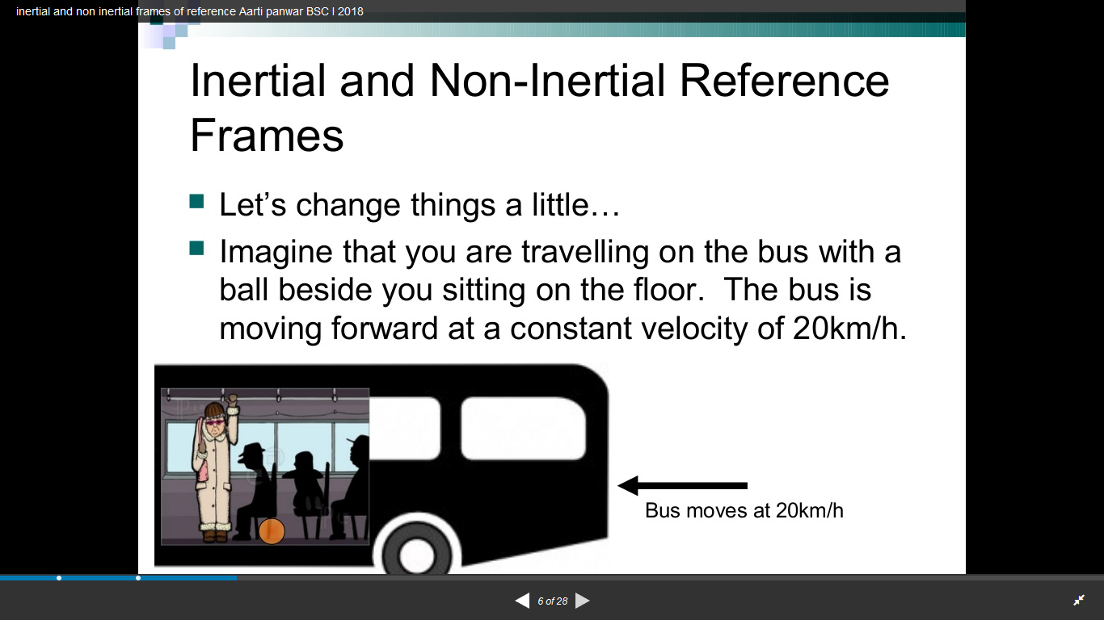

Slide 33
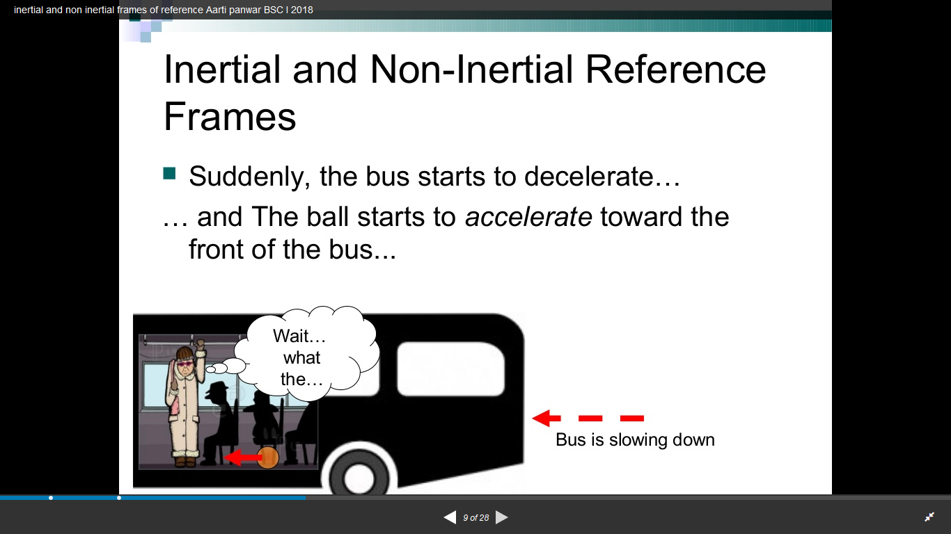

Slide 34
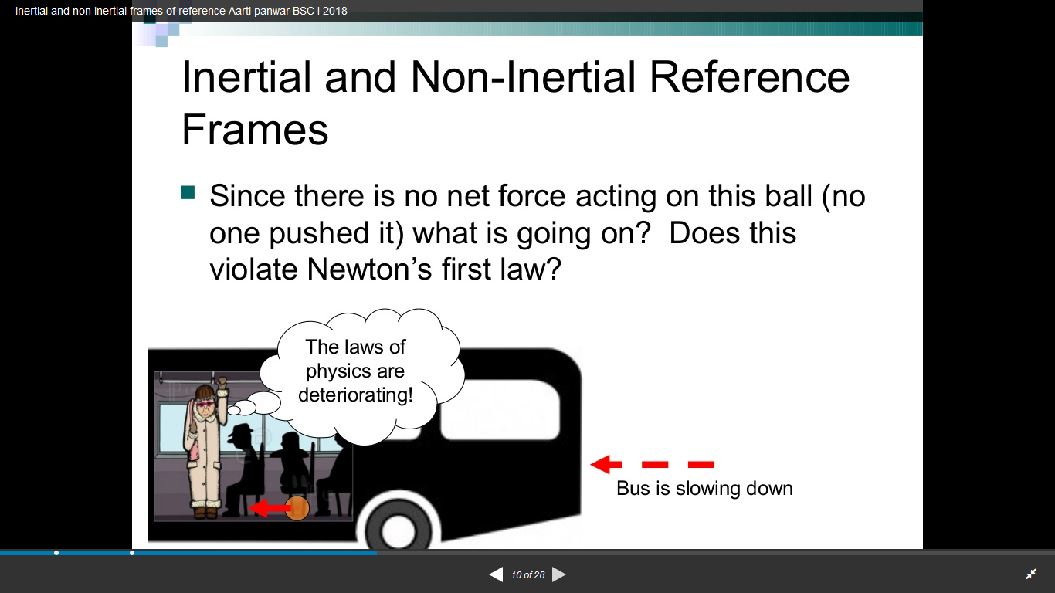

Slide 35
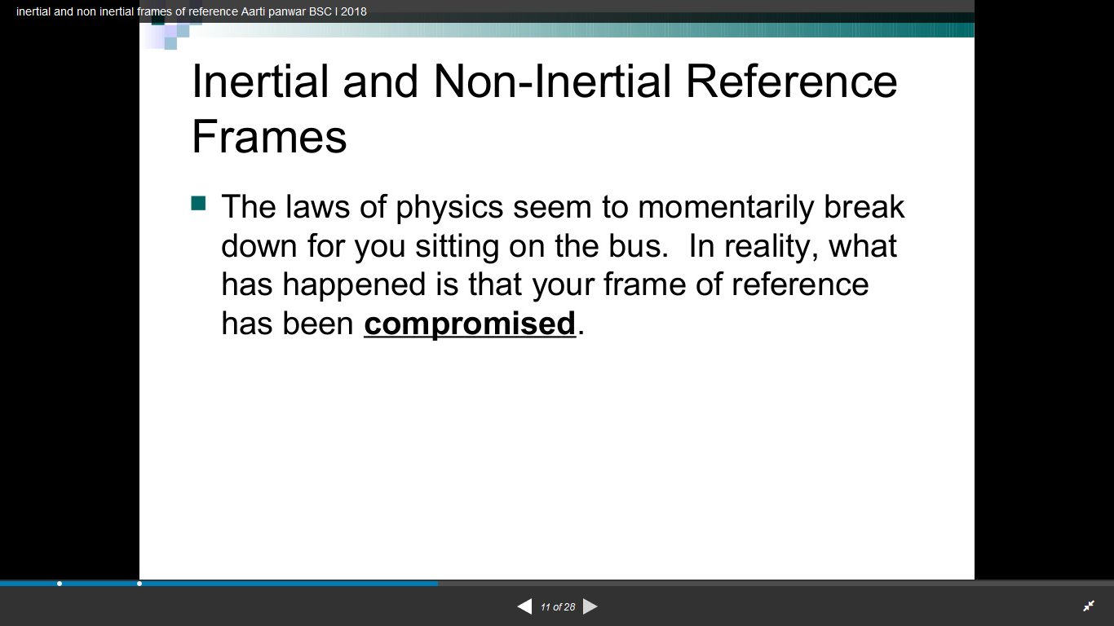

Slide 36
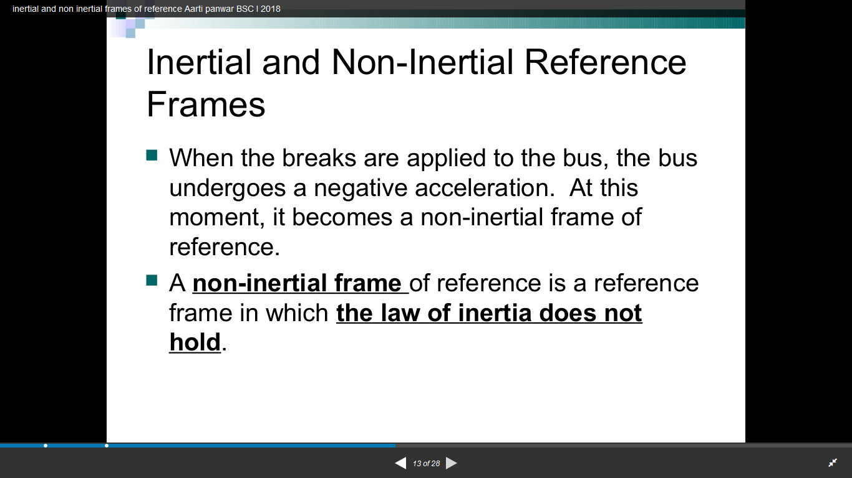

Slide 37
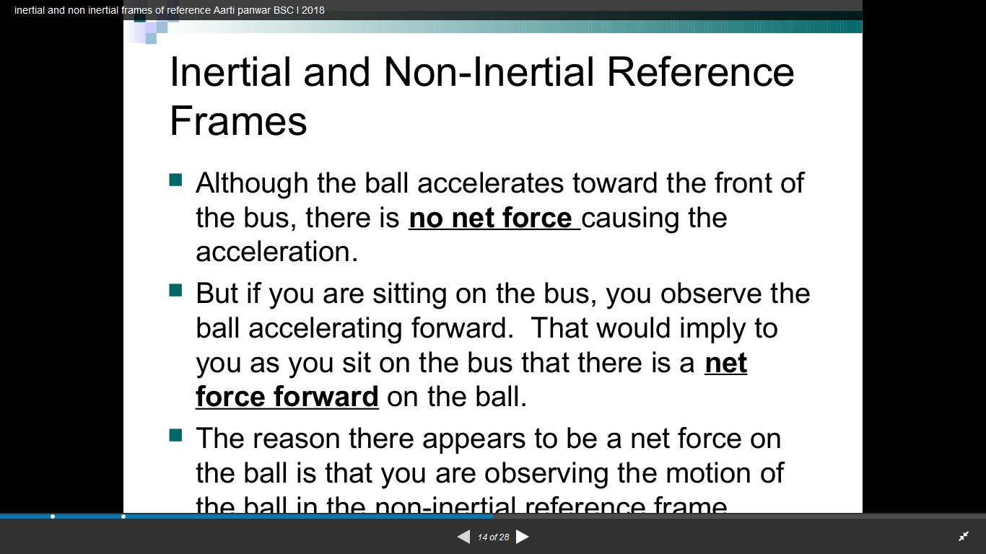

Slide 38
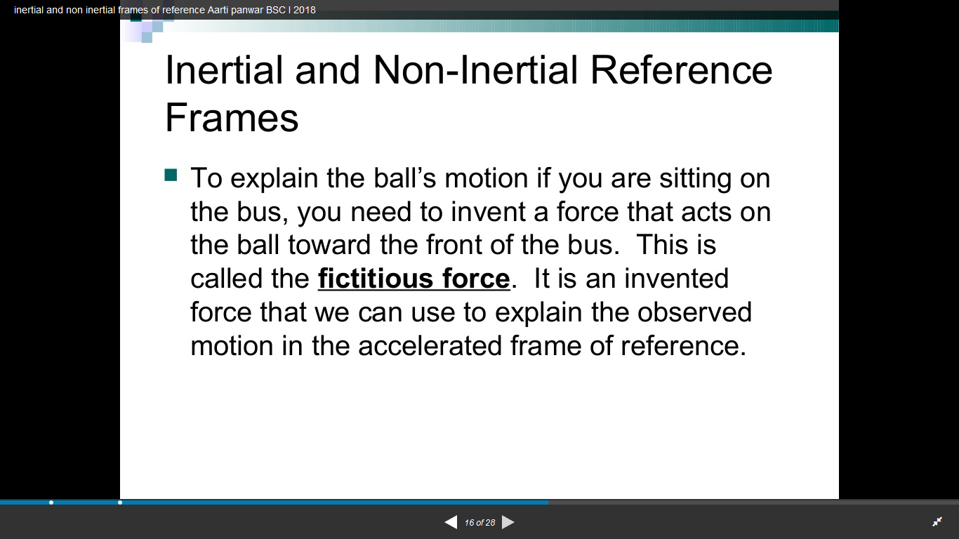

Slide 39
Inertial and Non-inertial frame of reference
A frame in which an observer sits and makes observations is called frame of reference .
Inertial frame of reference.
A frame of reference which is either at rest or moving with constant velocity is known as inertial frame of reference.
Newton’s laws are valid in this frame.
Also known as unaccelerated frame.
Non-inertial frame of reference.
A frame of reference moving with some acceleration is known as non-inertial frame of reference.
Newton’s laws are not valid in this frame.
Acceleration will never be zero for such frame of reference.

Slide 40
What is Pseudo Force?
A Pseudo force (also called a fictitious force, inertial force or d’Alembert force) is an apparent force that acts on all masses whose motion is described using a non-inertial frame of reference frame, such as rotating reference frame.
Pseudo force comes in effect when the frame of reference has started acceleration compared to a non-accelerating frame.
The force F does not arise from any physical interaction between two objects, but rather from the acceleration ‘a’ of the non-inertial reference frame itself. As a frame can accelerate in any arbitrary way, so can pseudo forces be as arbitrary (but only in direct response to the acceleration of the frame). However, four pseudo forces are defined for frames accelerated in commonly occurring ways: [one by a relative acceleration of the origin in a straight line (rectilinear acceleration);] two involving rotation: Coriolis force and Centrifugal force [and fourth called Euler force, caused by a variable rate of rotation.]

Slide 41
Examples of Pseudo Force:
A person standing at a bus stop watching an accelerating car, he infers that a force is exerted on the car and it is accelerating. Here there is no problem and the pseudo force concept is not required
But, if the person inside the accelerating car is looking at the person standing at the bus stop, he finds that the person is accelerating with respect to the car, though no force is acting on it. Here, the concept of pseudo force is required to convert the non-inertial frame of reference to an equivalent inertial frame of reference.
A ball hung from the roof of a train by means of an inextensible string. If the train is at rest or is moving with a uniform speed in a straight line the string will be vertical. A passenger will infer that the net force acting on the ball is zero.
If the train begins to accelerate, then the string will be making an angle with respect to the vertical. For the passenger, there are only two forces, and they are not collinear. But, the ball remains apparently in a state of equilibrium (as long as the acceleration of the train is constant). Here, the concept of pseudo force is required.

Slide 42
Centrifugal Force
Circular motion can be analysed from two different frames of reference. One is the inertial frame (which is either at rest or in uniform motion) where Newton’s laws are obeyed. The other is the rotating frame of reference which is a non-inertial frame of reference as it is accelerating. When we examine the circular motion from these frames of reference the situations are entirely different. To use Newton’s first and second laws in the rotational frame of reference, we need to include a pseudo force called ‘centrifugal force’. This ‘centrifugal force’ appears to act on the object with respect to rotating frames. To understand the concept of centrifugal force, we can take a specific case and discuss as done below.

Slide 43
Consider the case of a whirling motion of a stone tied to a string. Assume that the stone has angular velocity ω in the inertial frame (at rest). If the motion of the stone is observed from a frame which is also rotating along with the stone with same angular velocity ω then, the stone appears to be at rest. This implies that in addition to the inward centripetal force −mω2r there must be an equal and opposite force that acts on the stone outward with value + mω2 r. So the total force acting on the stone in a rotating frame is equal to zero (−mω 2 r + mω2r = 0). This outward force +mω2r is called the centrifugal force. The word ‘centrifugal’ means ‘flee from center’. Note that the ‘centrifugal force’ appears to act on the particle, only when we analyse the motion from a rotating frame. With respect to an inertial frame there is only centripetal force which is given by the tension in the string. For this reason centrifugal force is called as a ‘pseudo force’. A pseudo force has no origin. It arises due to the non inertial nature of the frame considered.

Slide 44
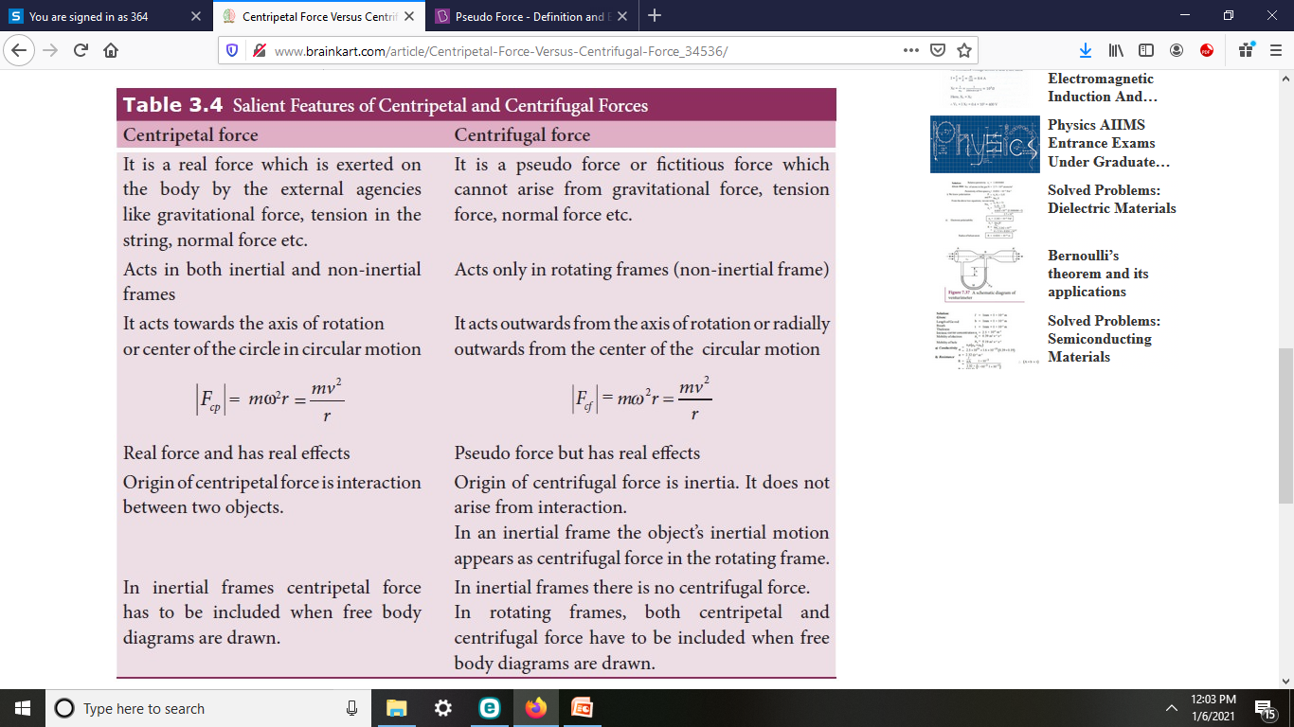

Slide 45
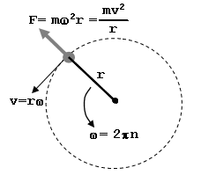
Pseudo forces { fictitious forces}
A force that appears to be act on an object whose motion is describes in the non inertial frame of reference is known as Pseudo forces.
The direction of such forces is opposite to direction of motion of frame of reference.
For example : Consider a car decelerating. As the driver applies the brakes, the direction of the actual force is opposite the direction the car would be travelling. However, the driver would experience a force pushing him towards the direction the car is going. This force would be called the pseudo or fictitious force, and the same example would apply for a car accelerating.
Pseudo forces are measurable.
Centrifugal Force :
When a body of mass ‘m’ rotates about an axis it exerts an outward radial force
upon the axis or from the axis which restrains it from moving in a straight line
is called Centrifugal force.
It exists only when the centripetal force is present.
Centrifugal force is used by washing machine dryers where the spinning of the rotor in a washing machine generates a centrifugal force that causes the clothes to move away from the center. This causes the water to be forced out of the wet clothes through the holes present in the chamber.

Slide 46
Coriolis Force
Coriolis force is an inertial or fictitious force that acts on the object with velocity V⃗ that are in motion within the frame of reference. If the frame of reference has a clockwise rotation, then the force acts to the left of the object and if the frame of reference has an anti-clockwise rotation, the force acts to the right of the object
Coriolis effect and its causes
Coriolis effect is used to describe the Coriolis force experienced by the moving objects such that the force is acting perpendicular to the direction of motion and to the axis of rotation. The earth’s rotation is the main cause for Coriolis effect as the earth rotates faster at the equator and near the poles the rotation is sluggish. This is because the rate of change in the diameter of the earth’s latitude increases near the poles.
The air currents in the Northern hemisphere bend to the right making the objects deflect to the right whereas in the Southern hemisphere the air currents bend to the left making the objects deflect to the left. The Coriolis effect is noticed only for the motions occurring at large-scale such as movement of air and water in the ocean. Example of Coriolis effect is change in weather patterns

Slide 47
Coriolis Force
Coriolis force is an inertial or fictitious force that acts on objects that are in motion within a frame of reference that rotates with respect to an inertial frame.
In a reference frame with clockwise rotation, the force acts to the left of the motion of the object.
In one with anticlockwise (or counterclockwise) rotation, the force acts to the right.
Deflection of an object due to the Coriolis force is called the Coriolis effect.
Coriolis effect is used to describe the Coriolis force experienced by the moving objects such that the force is acting perpendicular to the direction of motion and to the axis of rotation.
The earth’s rotation is the main cause for Coriolis effect as the earth rotates faster at the equator and near the poles the rotation is sluggish. This is because the rate of change in the diameter of the earth’s latitude increases near the poles..

Slide 48
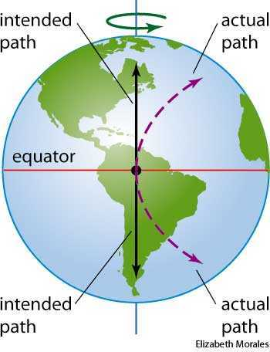
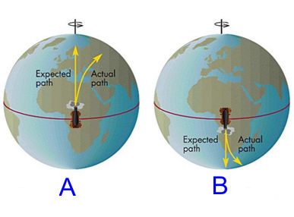
Coriolis Force
The air currents in the Northern hemisphere bend to the right making the objects deflect to the right whereas in the Southern hemisphere the air currents bend to the left making the objects deflect to the left. The Coriolis effect is noticed only for the motions occurring at large-scale such as movement of air and water in the ocean.
Example :change in weather patterns

Slide 49
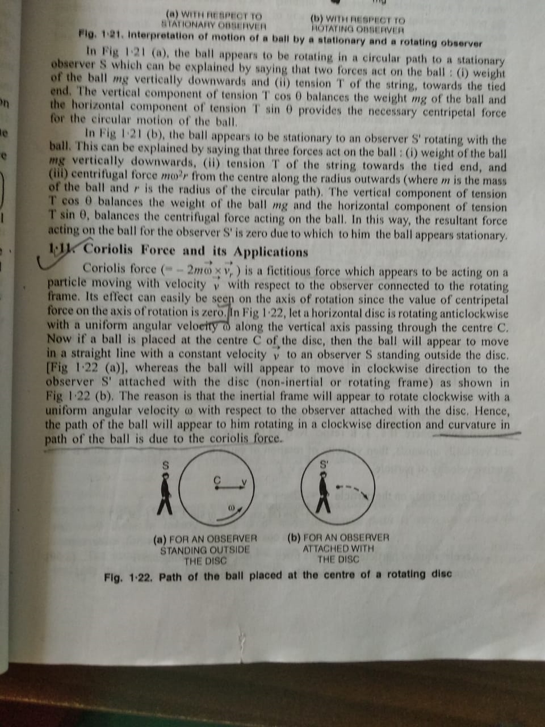
Coriolis Force

Slide 50
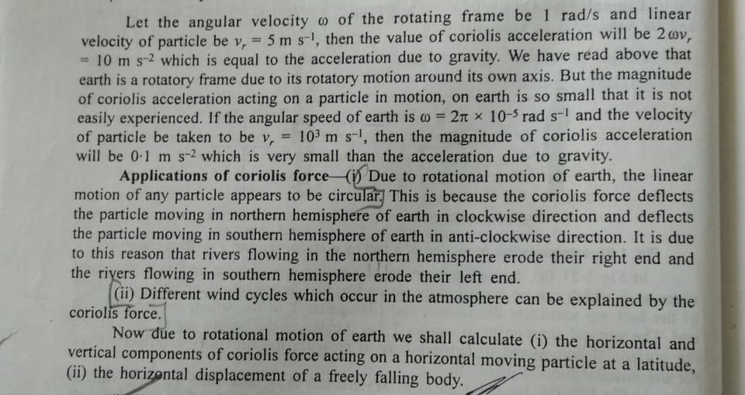

Slide 51
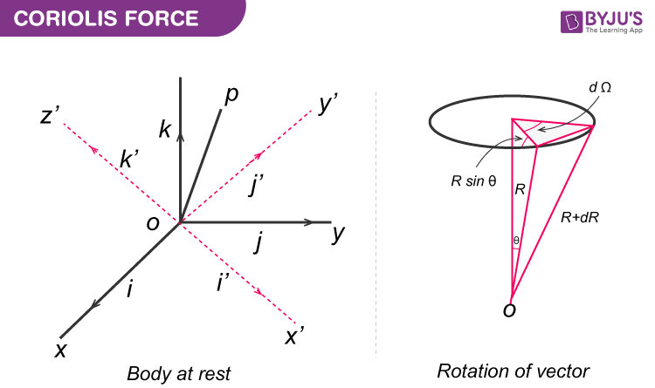
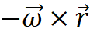
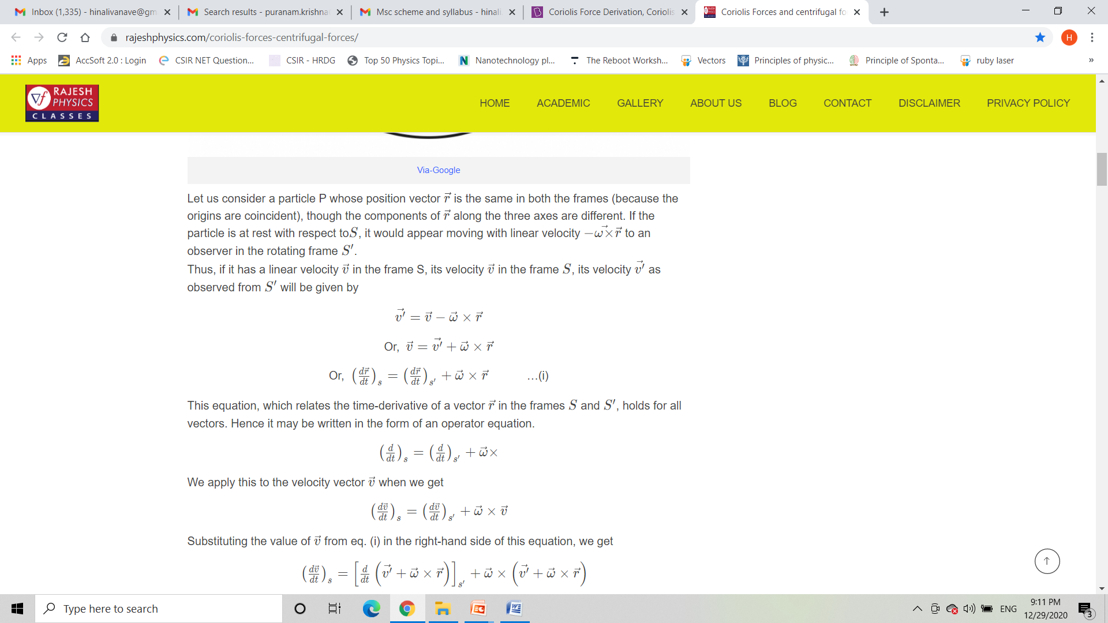
Coriolis force Derivation
Consider S(x,y,z) be inertial and S’(x’,y’,z’) be non inertial frame of
reference rotating with uniform angular velocity relative to S.
Both frames of references have common origin ’O’ and axis of rotation of S’
about S passes through this origin.
Now, Consider a particle P whose position vector same for both the frames,
but components along the three axes are different.
If a particle is at rest with respect to S ,it will appears to be moving with linear
Velocity to an observer in S’

Slide 52
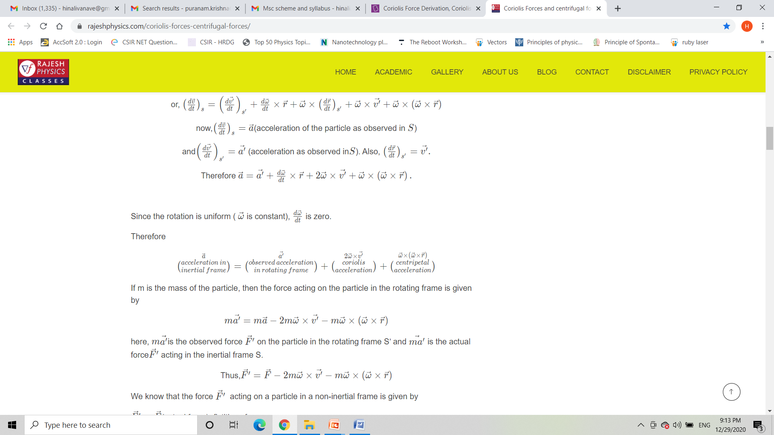
Coriolis force Derivation

Slide 53
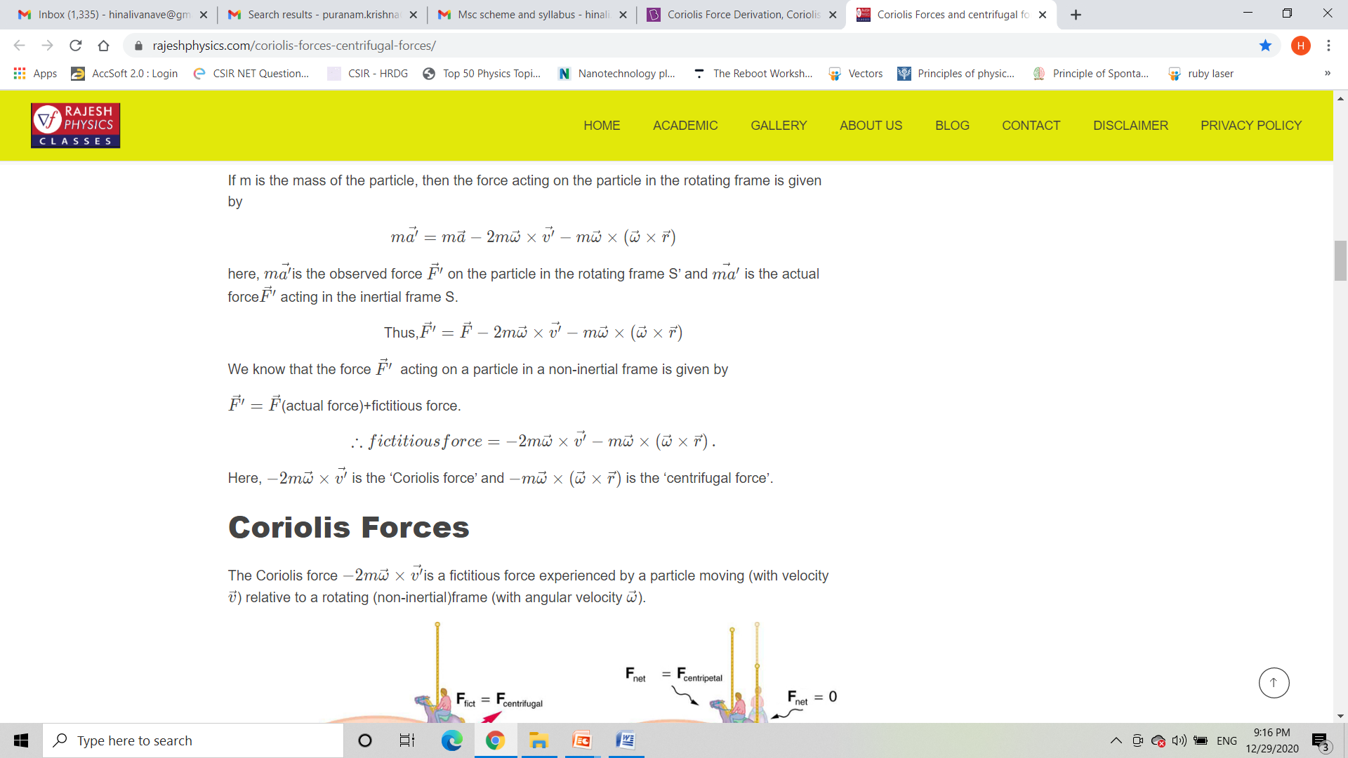
Coriolis force Derivation

Slide 54
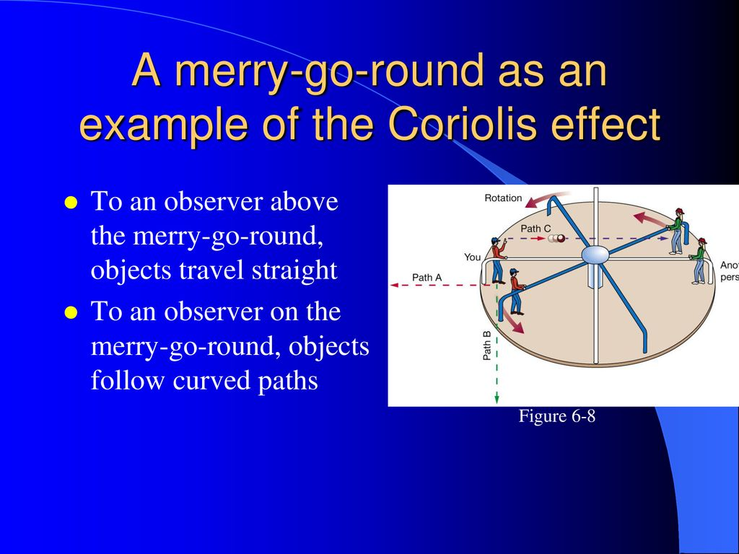

Slide 55
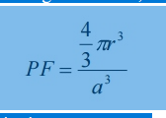
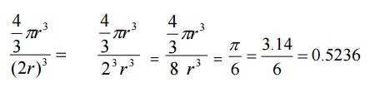
Simple Cubic Crystal
(iv) Packing factor
Number of the atoms per unit cell=1
Volume of one atom v = 4/3 πr³
Where r is the atomic radius
Side of the unit cell, a=2r
Atomic radius r=a/2
Total volume of the unit cell V=a³
We know the packing factor= v/V
Substituting for v and V, we have
Substituting a=2r , we get
Thus 52% of the volume of the simple cubic unit cell is occupied by atoms and the remaining 48% of the volume of the unit cell is Vacant.

Slide 56
2. BCC
In body centered cubic structure, the unit cell has one atom at each corner of the cube and one at body center of the cube. Figure 3.8 shows the arrangement of the atoms in a bcc cell.
(i) Number of atoms per unit cell
In a body centered crystal structure, the atoms touch along the diagonal of the body. Each and every corner atoms are shared by eight adjacent unit cells. Therefore, the total number of atoms contributed by the corner atoms is 1/8 x 8 =1 atom.
One full atom at the center of the unit cell = 1 atom
Therefore, total number of atoms present in the bcc unit cell = 1+1 = 2 atoms.
(ii) Coordination Number
The coordination number of the body centered cubic unit cell is calculated as follows.
Let us consider a body-centered atom. The nearest neighbor for a bcc atom is corner atom. A body centered atom is surrounded by 8 corner atoms. Therefore, the coordination number of a bcc unit cell is 8.

Slide 57
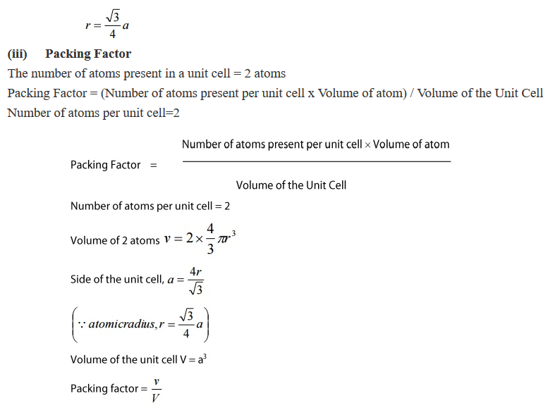
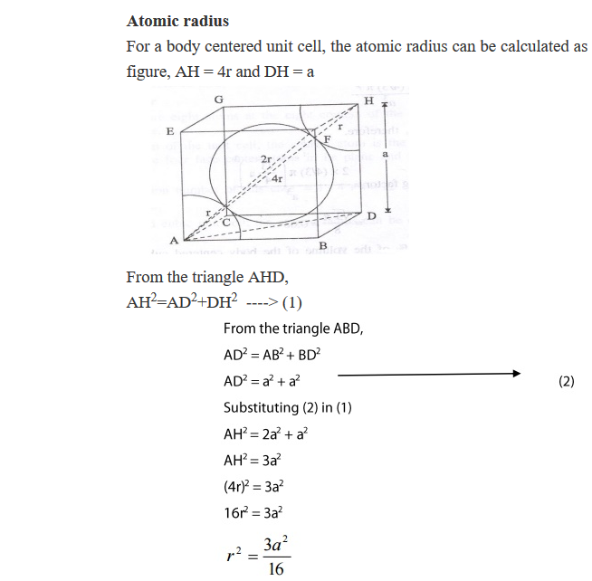
BCC

Slide 58
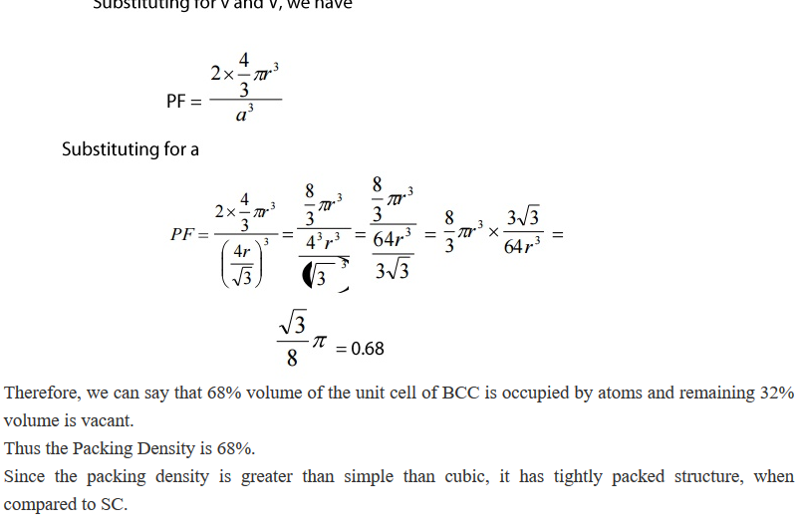
BCC

Slide 59
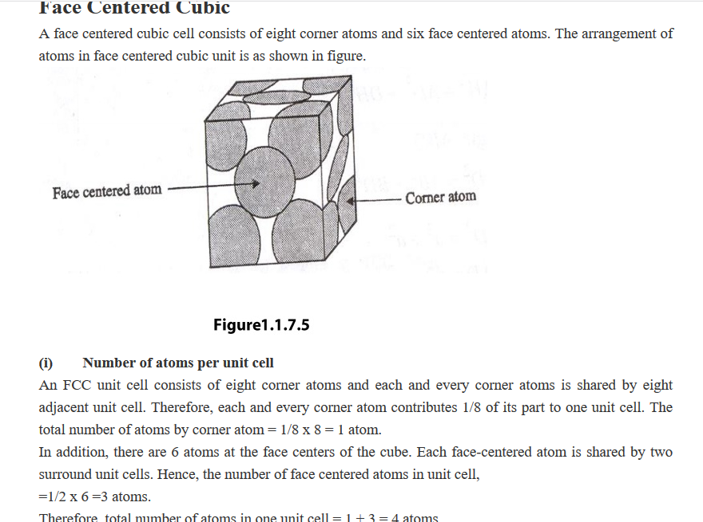
3. FCC

Slide 60
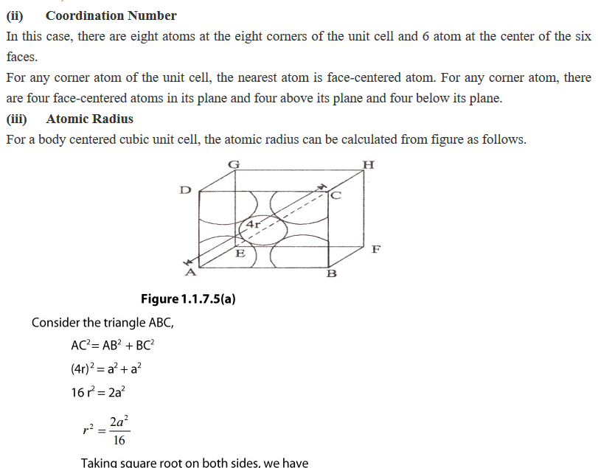

Slide 61


Slide 62

FCC

Slide 63
Lattice is defined as an array of points which are imaginarily kept to represent the position of atoms in the crystal that every lattice point has got the same environment as that o the other and hence one lattice point cannot be distinguished from the other lattice point.
Space Lattice or Crystal Lattice is a three dimensional collection of points in space. The environment about any particular point is in everyway the same.
The regular pattern of points which describe the three dimensional arrangement of particles in a crystal structure is called the Crystal Lattice or Space lattice.
Basis is formed by associating with every lattice point a uint of assembly of atoms or molecules identical in composition. This unit assembly is called Basis.
The Crystal Structure is formed by the addition of a basis to every lattice point.

Slide 64

indices.
A crystal lattice may be considered as an aggregate of a set of parallel equi-distant planes of high density of lattices points, Hence lattice planes are also called Cleavage Points.
The lattice planes can be chosen in a different number of ways, for example (a), (b), (c), and (d) as shown in the figure.

Slide 65
Miller Indices
The problem is that how to designate a plane in the crystal. Miller evolved a method to designate a plane in a crystal by three numbers (h,k,l) known as Miller indices.

Slide 66
Miller Indices
Miller introduced a system to designate a plane in a crystal. He introduced a set of three numbers to specify a plane a plane in a crystal. This set of three numbers is known as Miller Indices of the concerned plane.
Procedure for finding Miler Indices
Determine the intercepts of the plane along the axes X, Y and Z in terms of the Lattice Constant a, b, c.
Determine the reciprocals of these numbers.
Find the least common denominator (LCD) and multiply each by this LCD . The result is written in the form (hkl) and is called the Miller Indices of the plane.

Slide 67

Miller Indices
Example
Plane ABC (figure 1.1.5) has intercepts of 2 axial units on X-axis, 2 axial units on Y-axis and 1 axial unit on Z-axis.
The reciprocals are ½,1/2 and 1. The LCM is 2.
Multiplying each by 2 , we get 1,1,2. Hence the Miller Indices of the plane are (112)

Slide 68
Important Features of Miller Indices
When a plane is parallel to any axis, the intercept of the plane on that axis is infinity. Hence The Miller Indices for that axis zero.
If a plane cuts an axis on the negative side of the origin, corresponding index is negative.
The indices (hkl) do not define a particular plane but a set of parallel planes.
1 (a) Points to ponder
The Miller Indices should be enclosed only in this bracket.
There should not be any commas in between the numbers.
If the Miller Indices is say (2 6 3) means it should be read as two six three, and not as two hundred and sixty three.
The direction of plane can be represented by enclosing the Miller Indices in a square bracket. For example [2 6 3]
To represent the family of planes we can use this bracket i.e. ->
Putting a bar over the numbers can represent negative Miller Indices For an example (2 6 3) represents the plane with intercepts on negative axis, positive Y-axis and negative Z-axis.

Slide 69


